Slide 1

PHAS0048/0097: Astrophysics/Physics Project 24/25 Presentation
Observability of Circum-Planetary Disks
Vanessa Welke
Supervisor: Dr. Mihkel Kama

Slide 2
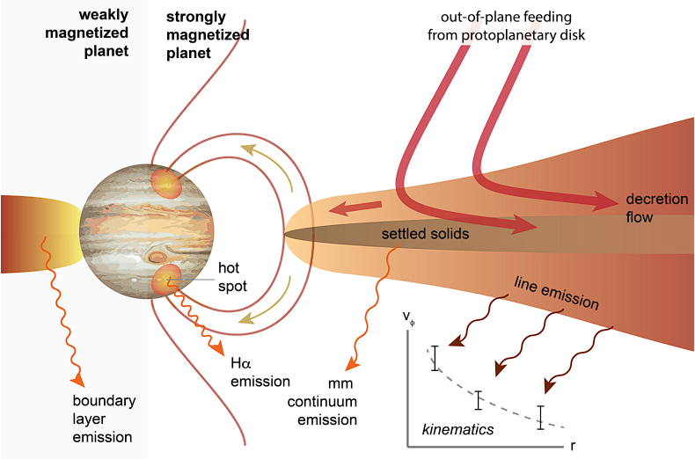
Introduction
Note:
CPDs (Circumplanetary Disks): around planets PPDs (Protoplanetary Disks): around stars CPDs form within PPDs
Circumplanetary disks (CPDs) are accretion disks around protoplanets.
Hypothesised birthplaces of exomoons, similar to Jupiter’s moons (Heller et al. 2015)
Key to understanding planet and satellite formation.
ALMA angular resolution goes as fine as 0.0048″, about the CPD size (< 1 au) in nearby distances (<100 pc).
CPD regulates how material accretes onto the planet.
1. Feeding from PPD
2. Settled solid = potential satellite formation zone
Cross section of hypothetical CPD structure
Credit: Armitage (2024)
Notes:
Due to sub-au spatial scales , challenging to detect with telescope
Its rare but there have been tentative CPD detections, mostly with the ALMA telescope. Recently

Slide 3
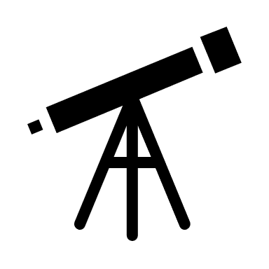
Project Aim:
Note:
CPDs (Circumplanetary Disks): around planets PPDs (Protoplanetary Disks): around stars CPDs form within PPDs
Develop an efficient, lightweight pipeline for generating mock CPD observations without relying on computationally expensive hydrodynamical simulations.
The pipeline runs from case-customized emission models to synthetic observations, supporting proposal design and interpretation of CPD detections.
Simplified model of the system
Simulate emission from model
Simulate synthetic observation of model emissions
Notes:
Build a customizable CPD-PPD model in Python, using the PDS 70 system as a reference.
Simulate dust continuum emission with RADMC-3D software, incorporating both stellar and planetary heating.
Determine the minimum observational conditiocns required for CPD detection with ALMA.
Derive the CPD radius and temperature from synthetic observations using the intensity profile.

Slide 4
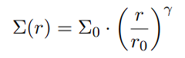
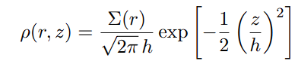
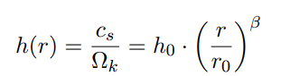
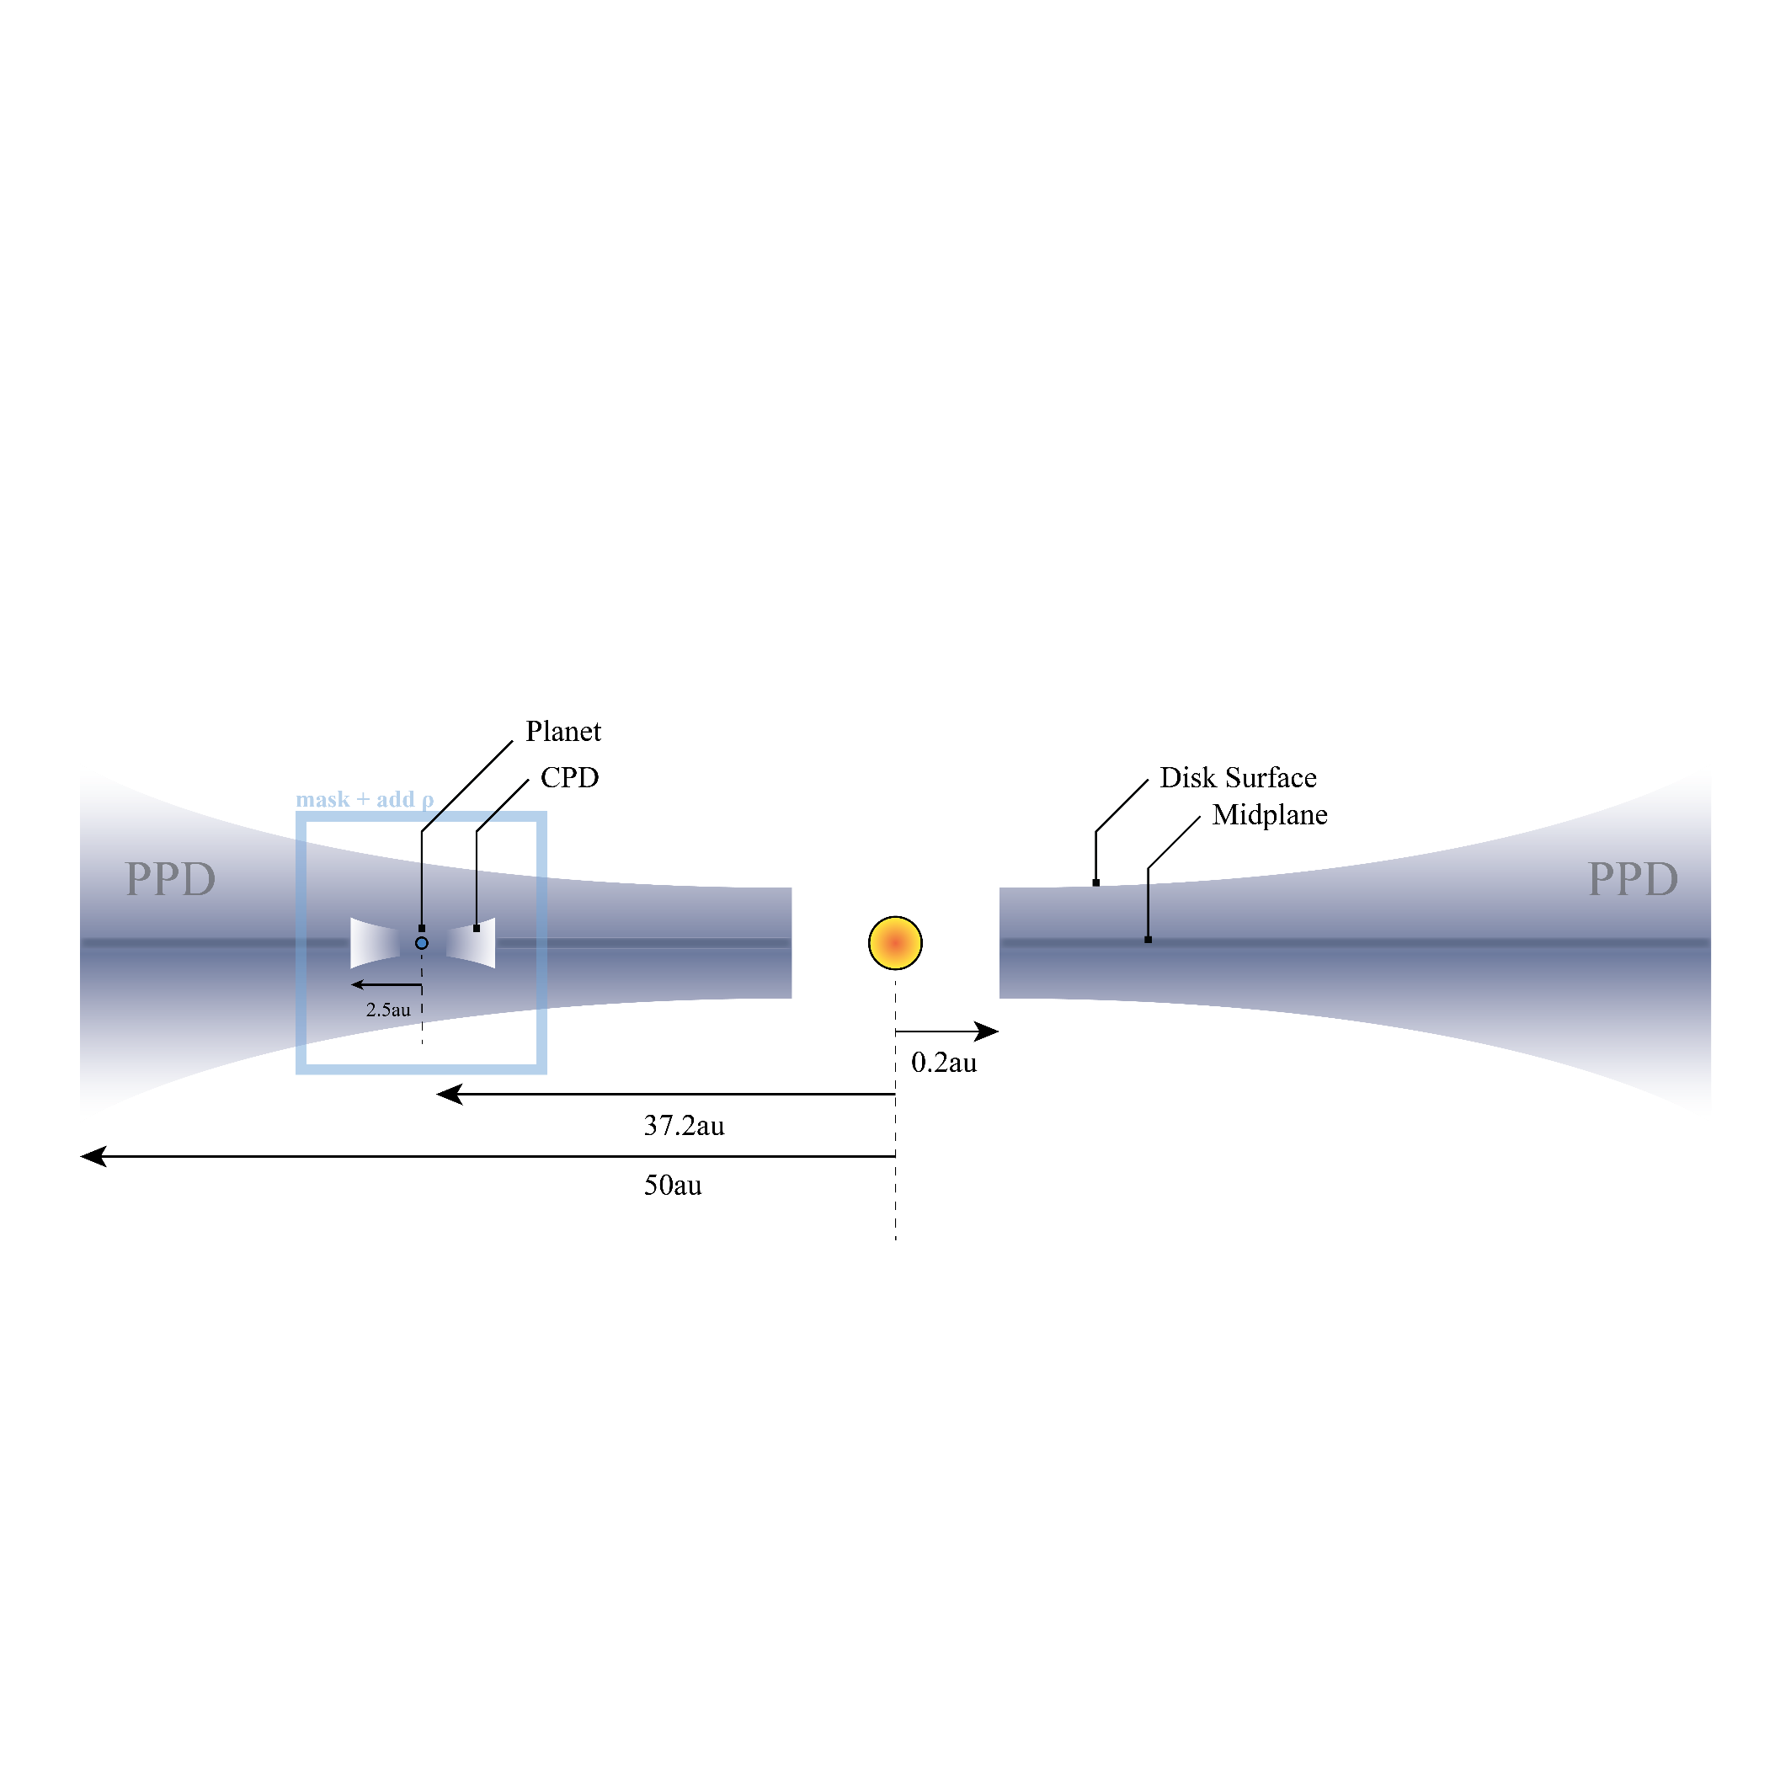
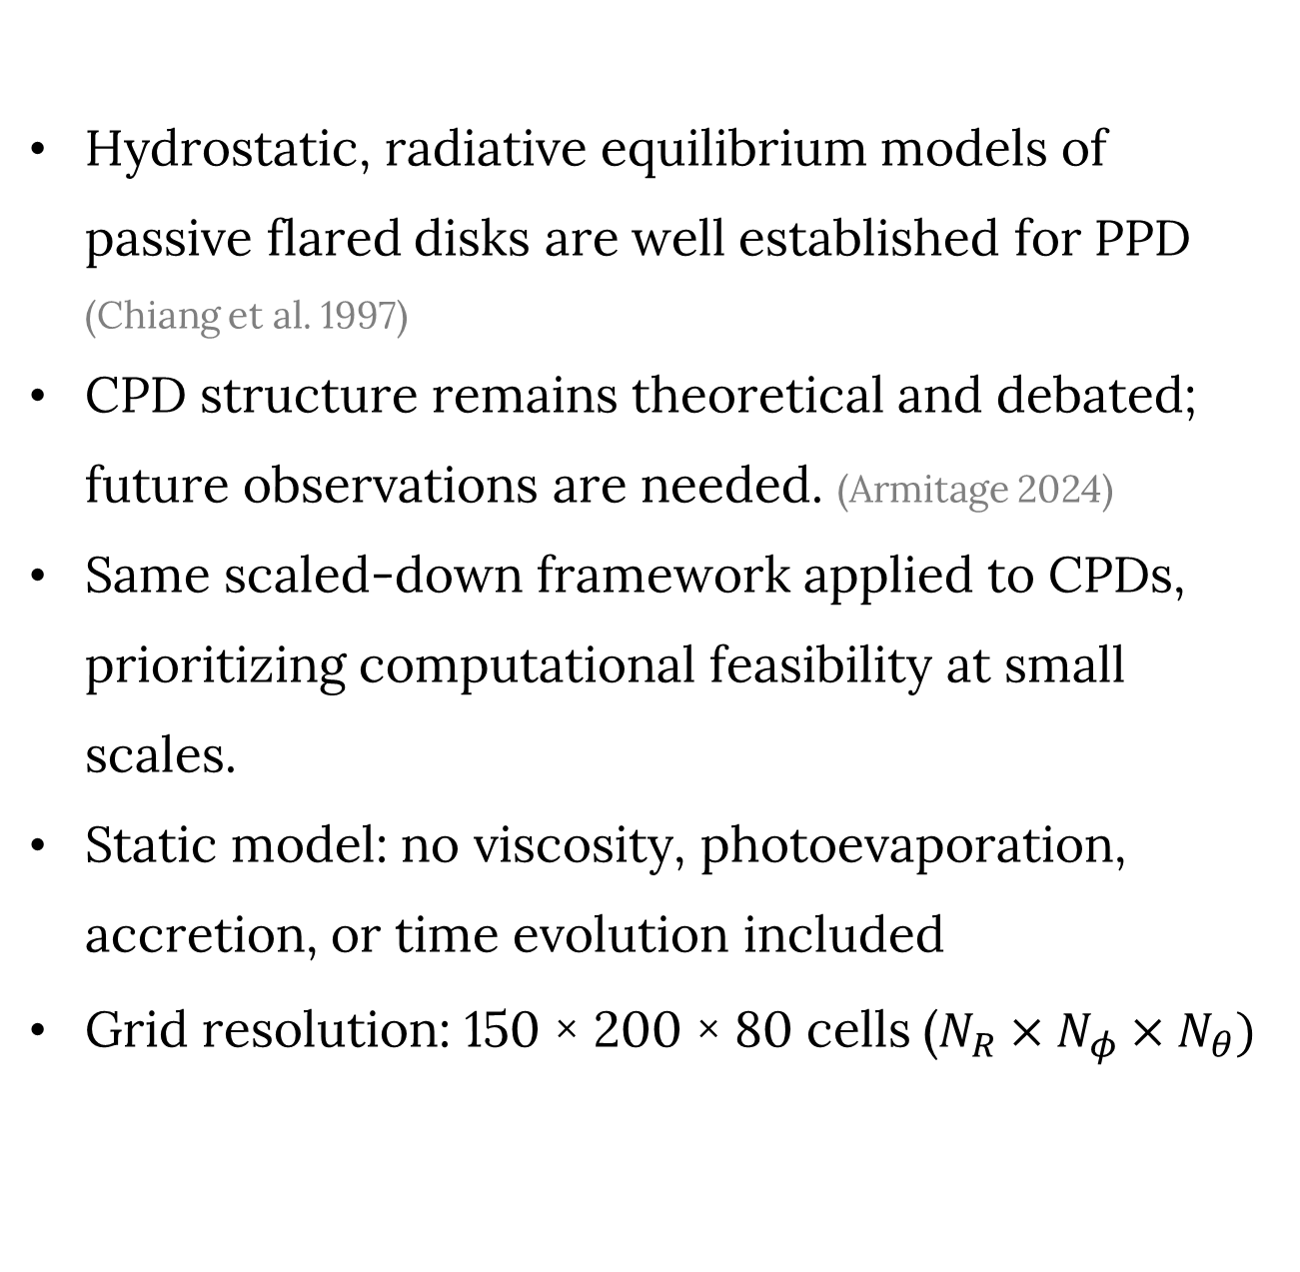
Modelling the System
Hydrostatic, radiative equilibrium models of passive flared disks are well established for PPD (Chiang et al. 1997)
CPD structure remains theoretical and debated; future observations are needed. (Armitage 2024)
Same scaled-down framework applied to CPDs, prioritizing computational feasibility at small scales.
Static model: no viscosity, photoevaporation, accretion, or time evolution included
Grid resolution: 150 × 200 × 80 cells ($N_{R}×N_{φ}×N_{θ})$
Surface density distribution
Vertical density distribution
Pressure scale height
How much the disk flares
90au
Notes:
CPDs are too small to be observed in isolation so I modeleed the system.
The PPD structure commonly employs a well established flared disk model with the power law surface density drop off and exponential decline in vertical direction . The scale height depends on distance from the central star and the index tells how much the disk flares.

Slide 5
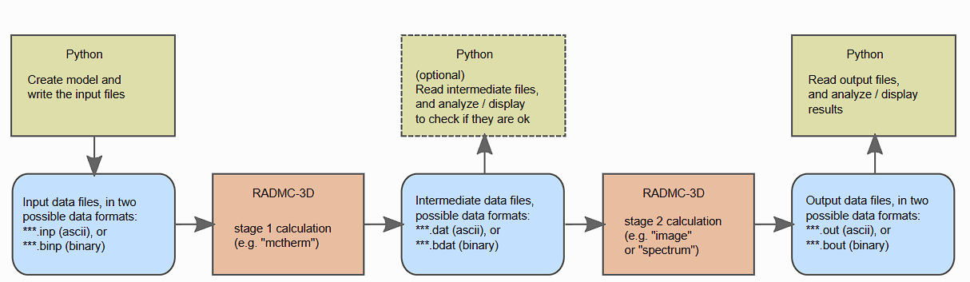

RADMC-3D
To simulate dust continuum emission from model:
Credit: Alexis Matter
Monte-Carlo run
(temperature-distribution)
Ray tracing
(image, spectrum)
Notes:
Model set up and dust opacity is input into radiative transfer post processing software
Employs a monte carlo algorithm to simulate photon propagate through grid of density cells from radiation sources -> yield dust equilibrium temperature.
The intermediate temperature is used used to generate wavelength dependet images and spectrum at ALMa observational frequencies
Outputs in FITS format for further analysis with CASA.

Slide 6
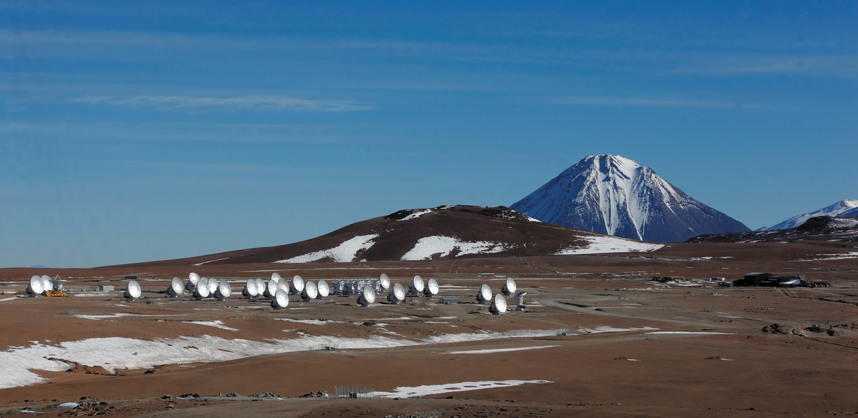
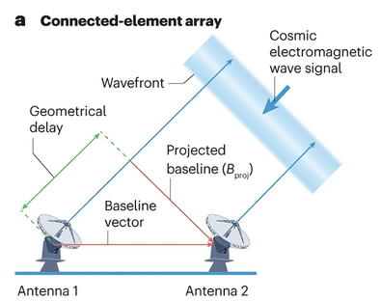
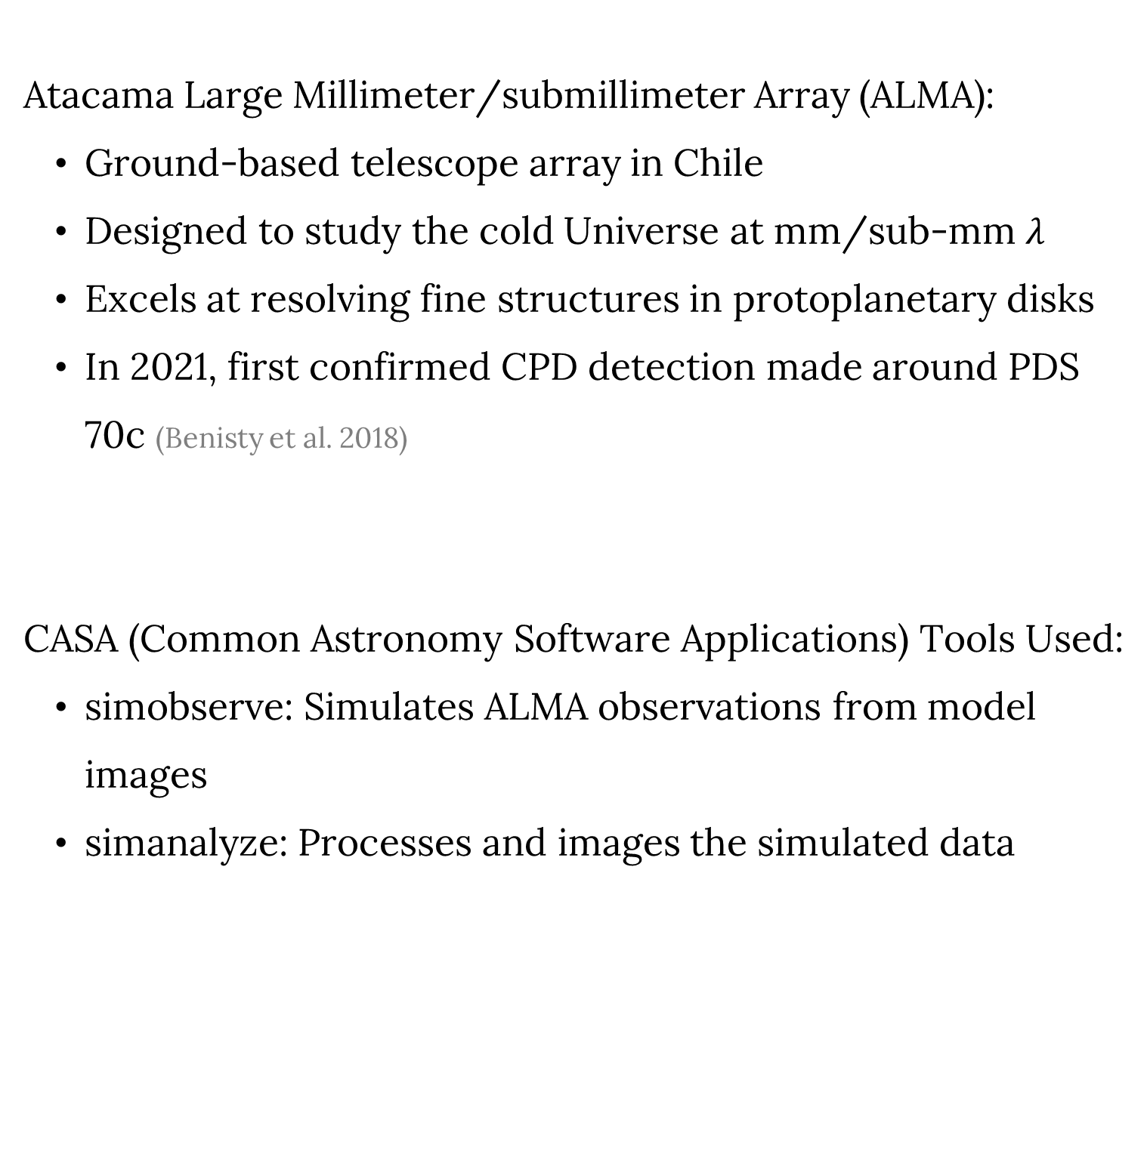
The ALMA Telescope and CASA
Atacama Large Millimeter/submillimeter Array (ALMA):
Ground-based telescope array in Chile
Designed to study the cold Universe at mm/sub-mm $λ$
Excels at resolving fine structures in protoplanetary disks
In 2021, first confirmed CPD detection made around PDS 70c (Benisty et al. 2018)
CASA (Common Astronomy Software Applications) Tools Used:
simobserve: Simulates ALMA observations from model images
simanalyze: Processes and images the simulated data
C. PADILLA/ALMA (ESO/NAOJ/NRAO)
Radio Telescope
Interferometric signals are sampled in the (u, v) plane and Fourier transformed to reconstruct the sky brightness distribution.

Slide 7
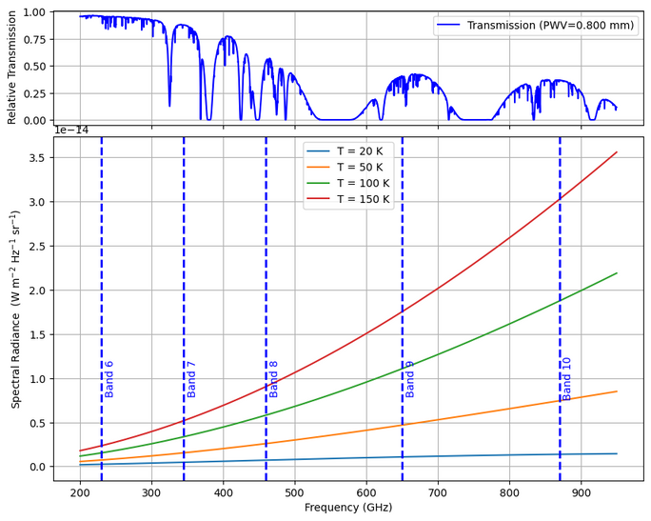
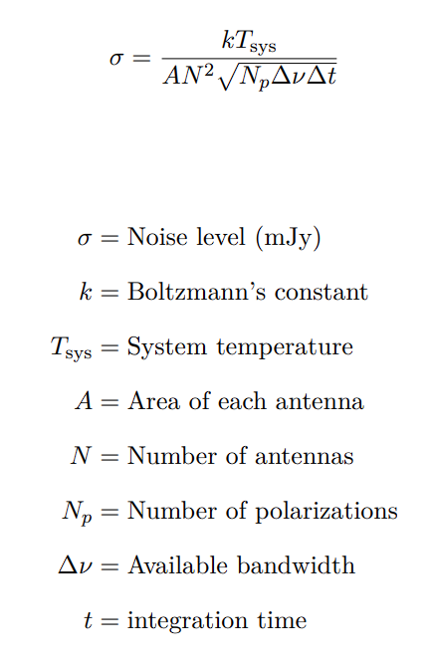
Observational Planning
Convert CPD intensity from Jy/pixel to Jy/beam (ALMA resolution)
Use ALMA longest baseline (16.2 km) for maximum angular resolution
Estimate total integration time for 5σ detection of CPD signal
Notes:
Parameters considered for observational planning : time , frequency , resolution
A robust detection must have the CPD brightness at least 5 times the background noise.
Time is estimated from this formulae relating the telescopic parameters after deciding a desired noise level’.
The desired noise level is 1/5 the CPD outer rim intensity
Resulting time ranges from minutes to days -> A standard 10 hr session is used to balance good image fidelity and sensible use of allocated telescopic time
As it ensures that under realistic condition, they can be robustly detected
For ground based tele
Wavelength depency of noise is visualized on the plot
So the final visibility of CPD will be a trade-off between the two factors.

Slide 8
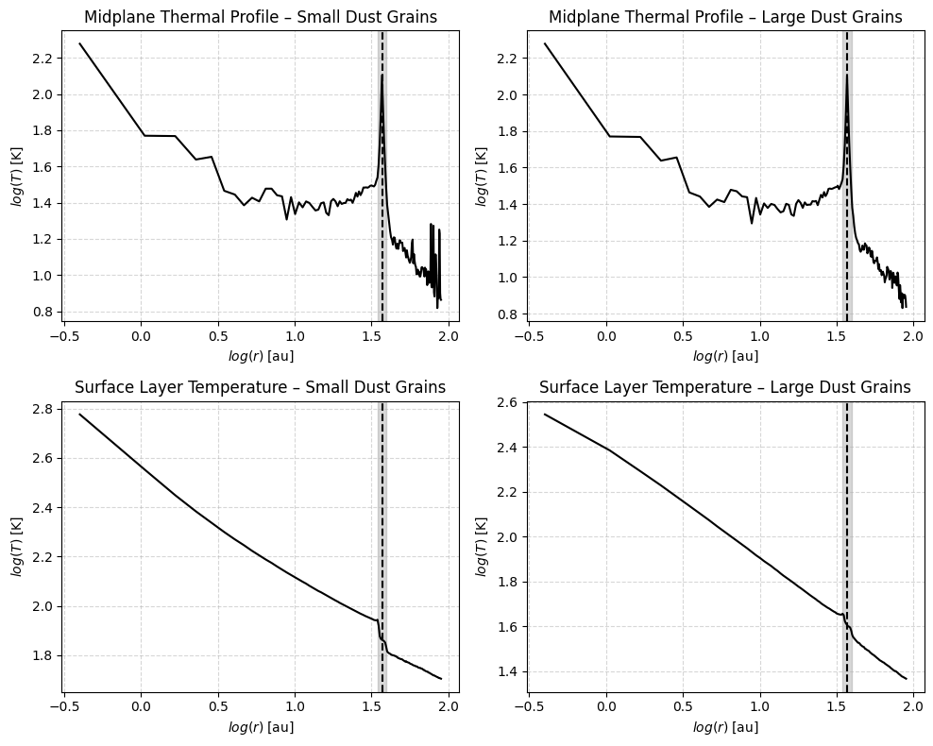
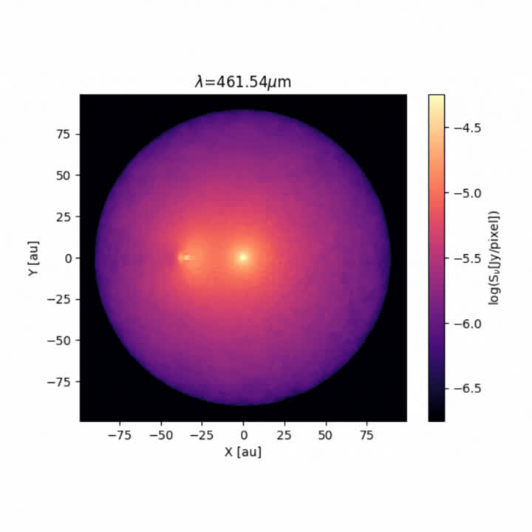
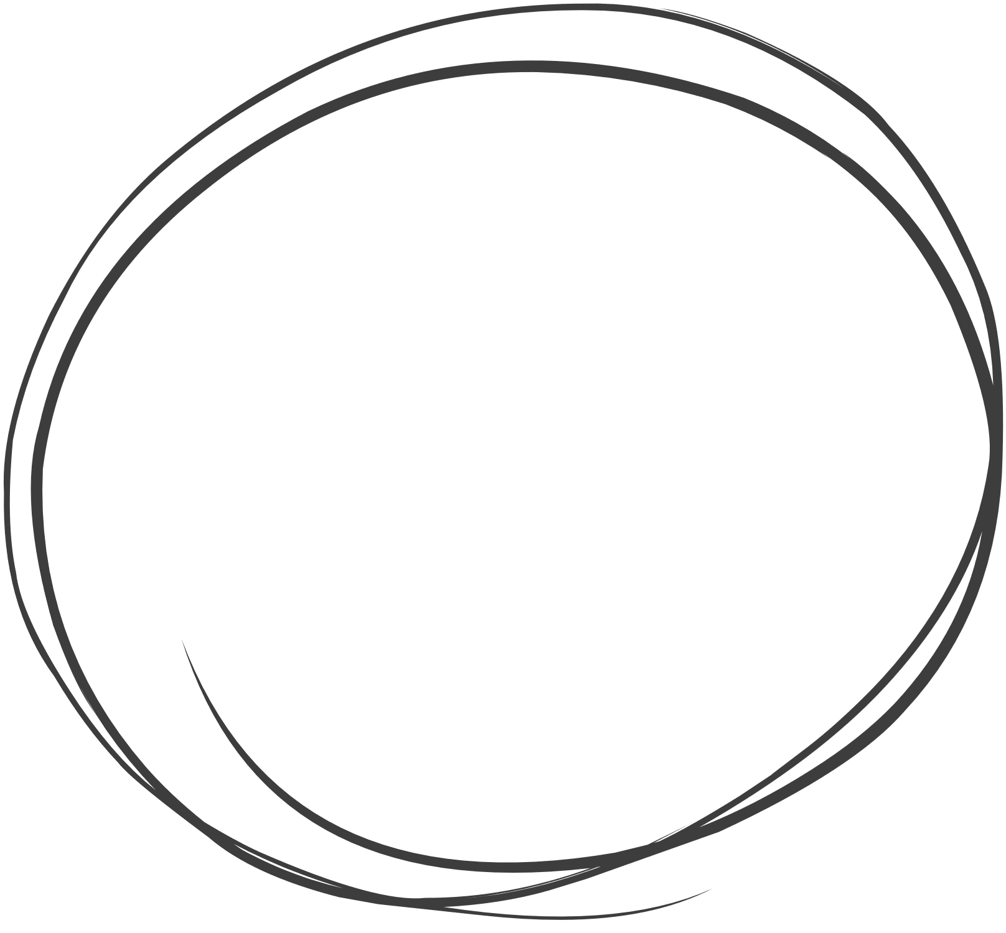
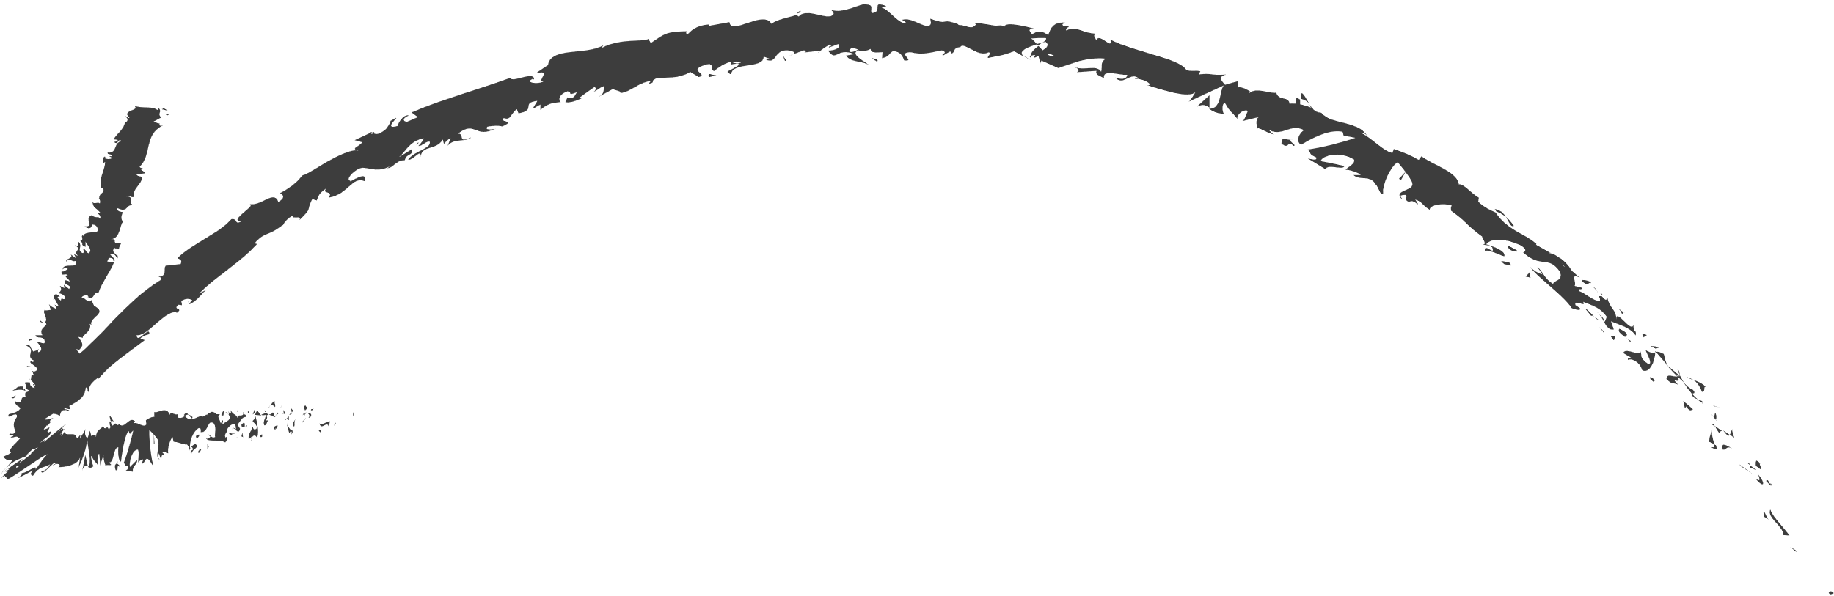
Thermal Structure and Radiative Emission of the Model Disk
Mass-weighted average dust temperature of 45.75 K
Brighter emission at higher frequency
Protoplanet
Star
Circum-planetary Disk
Notes:
Results:
The radial temperature profile in log-space revelals that in the CPD region, heating comes from stellar radiation (bump) and planet heating (spike)
The disk surface is hotter as it is directly exposed
Smaller griains are also more efficient at absorption and re-emission
The t profie is usefiul to probe simulation performance on whether noise is significant at the densest region of the set up, telling me if the set up is computationally feasible
A mass weighted temperature is calculated for the CPD..

Slide 9
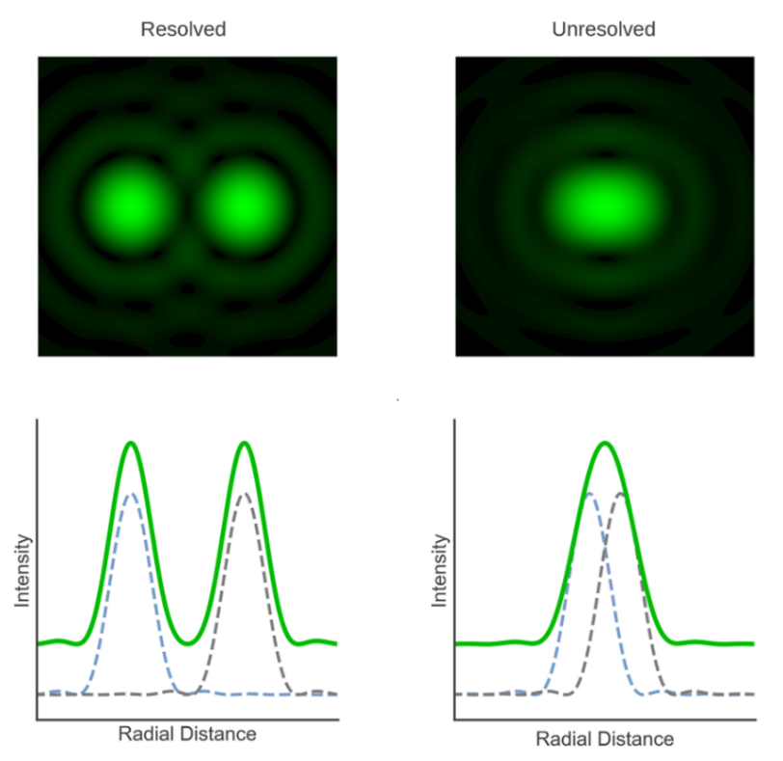
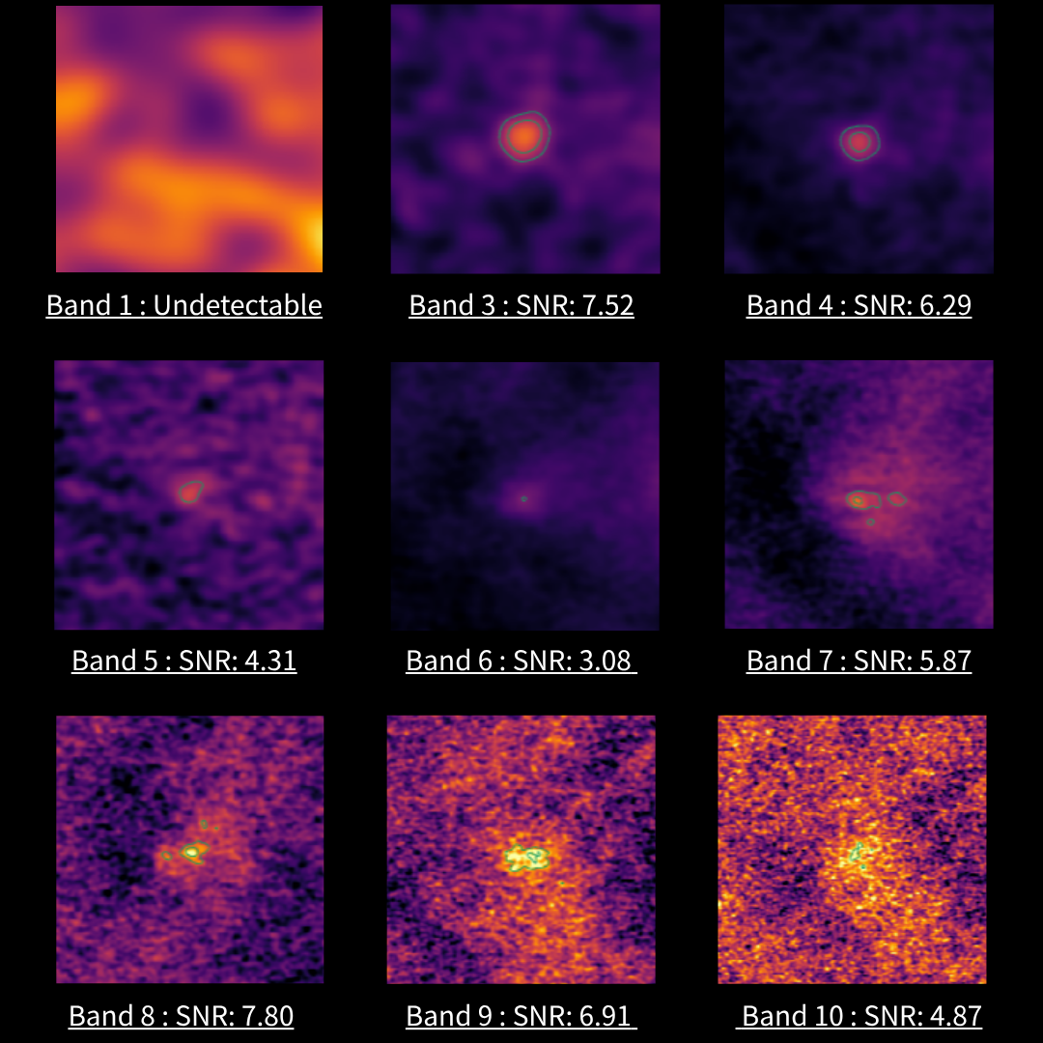
Impact of Observational Parameters on CPD Detectability
Green Contours:
Represent 3σ / 5σ levels
Lower Frequency Bands:
CPD unresolved, smooth shape
More background contamination from PPD
Higher Frequency Bands:
Stronger CPD emission
Higher atmospheric noise
Irregular CPD contours, less shape confidence
Notes:
A zoomed in section of the CPD reion in the ALMA tele with Banfd 1 being the longest wavelength
Green contours enclosed emission area above 3 and 5 sigma
Expectedly due to trade-off forementioned, no significant variation in SNR
Regarding shape of contour, low band CPD appear as a coherent bolb of flux because the ALMA beam is large enough to smooth out the flux, but it also smoothes out CPD’s radial flux gradient and blends in more bg contamination, leading ro rougher constrain of CPD and chanllenge to study internal gradients.
Higher frequency band where
the resolving power is higher, CPD covered by much more beams, the atmos noise contamination is too strong
And takes longer time to take in same amount of flux for each beam that CPD shape is fragmented.
Mitigated with long obs rimw

Slide 10
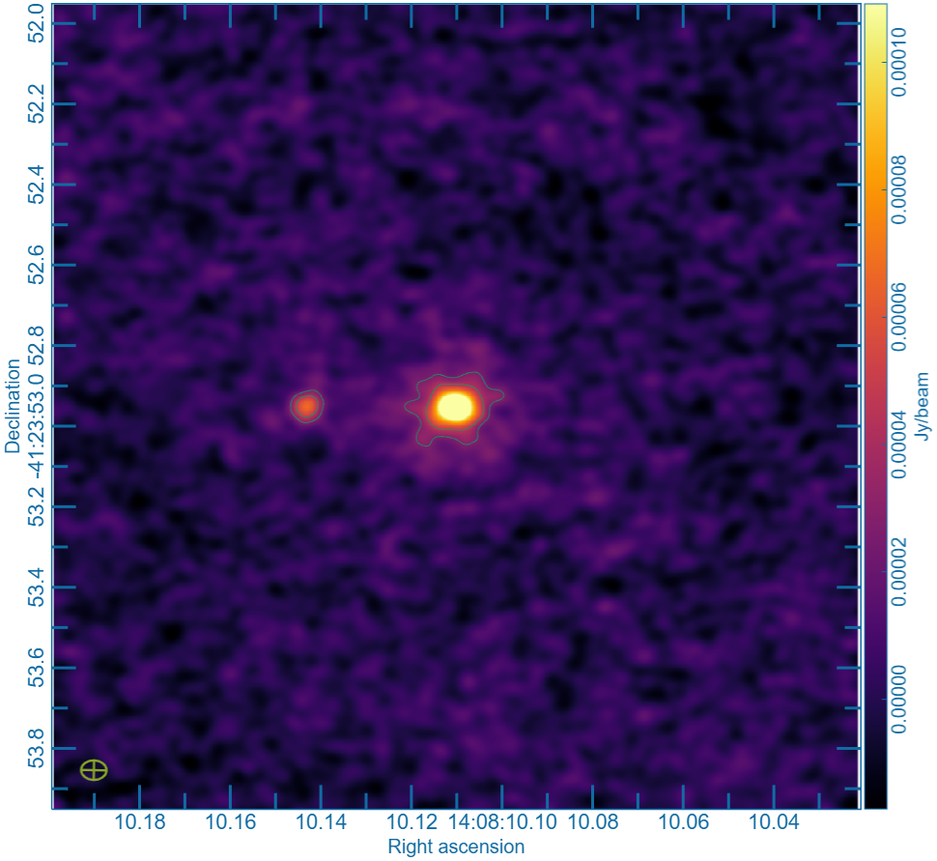
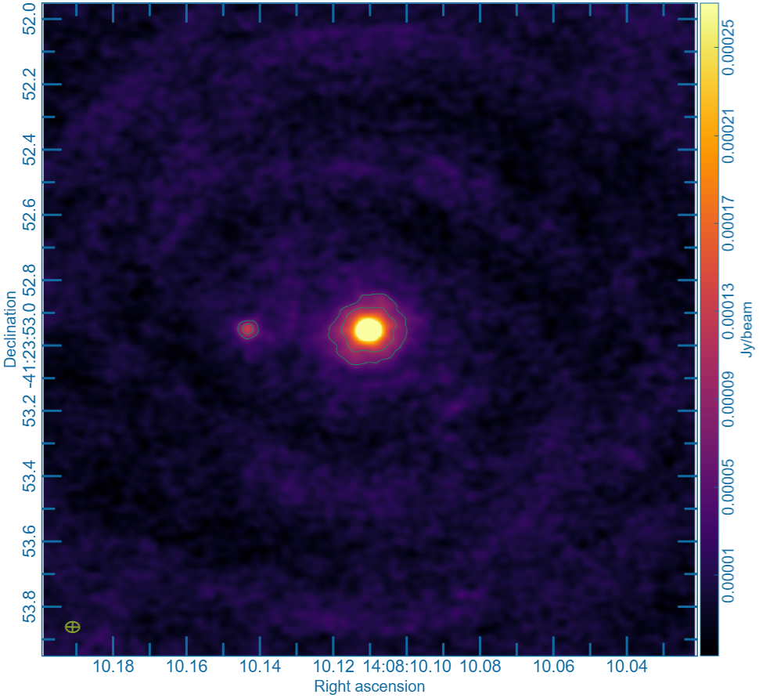
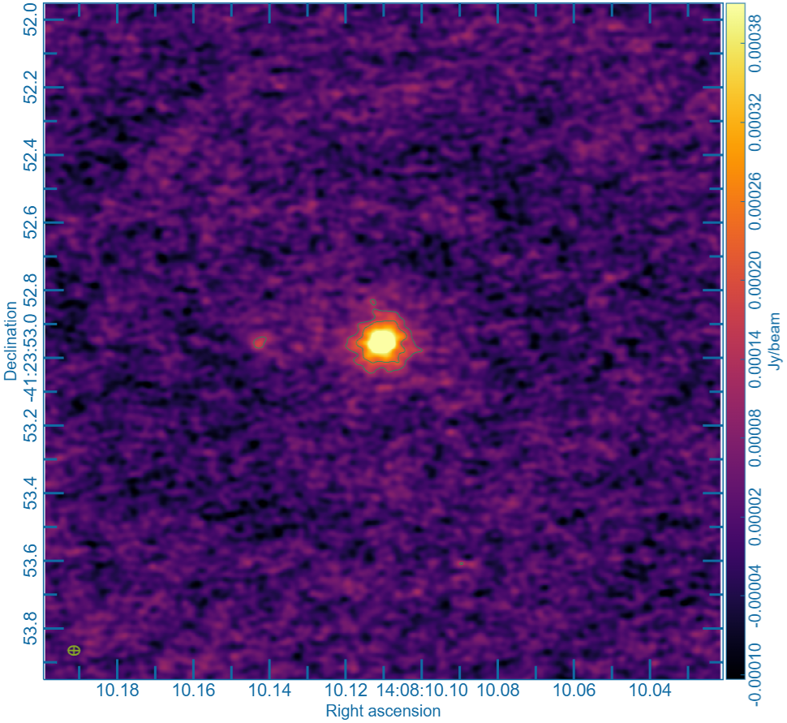
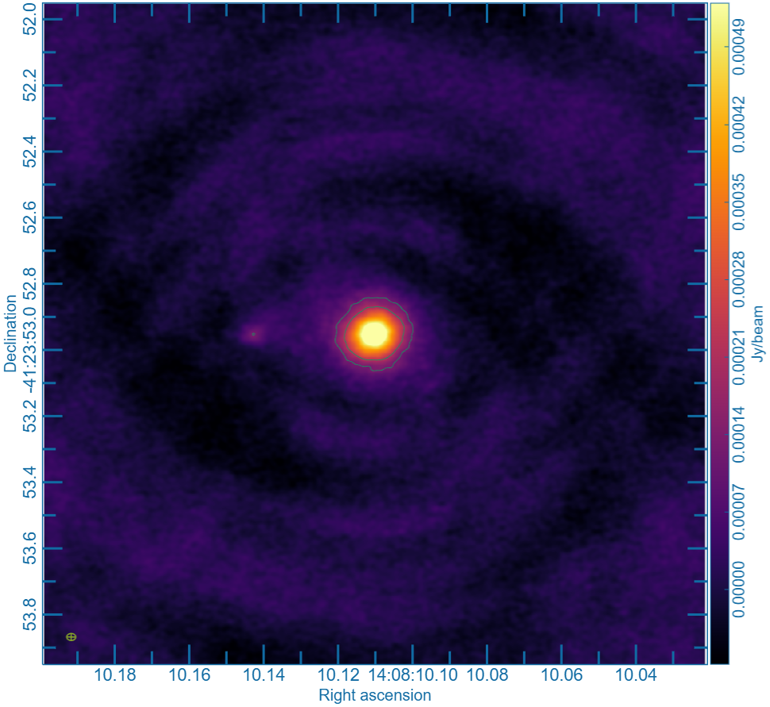
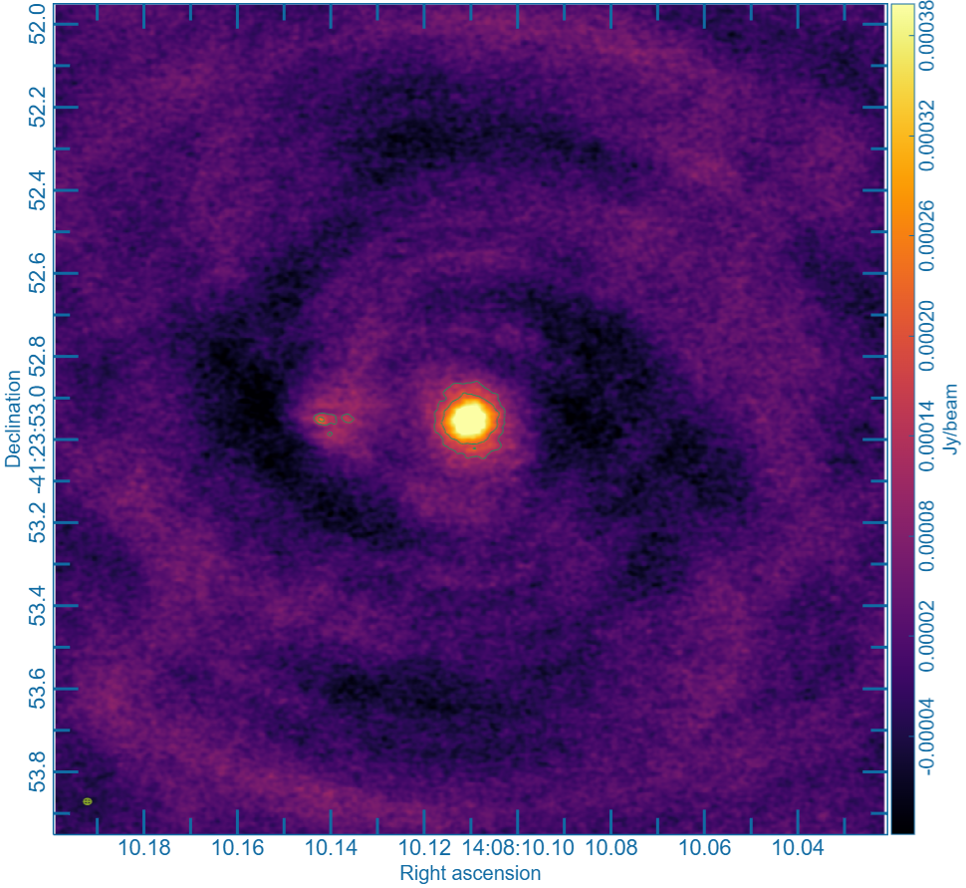
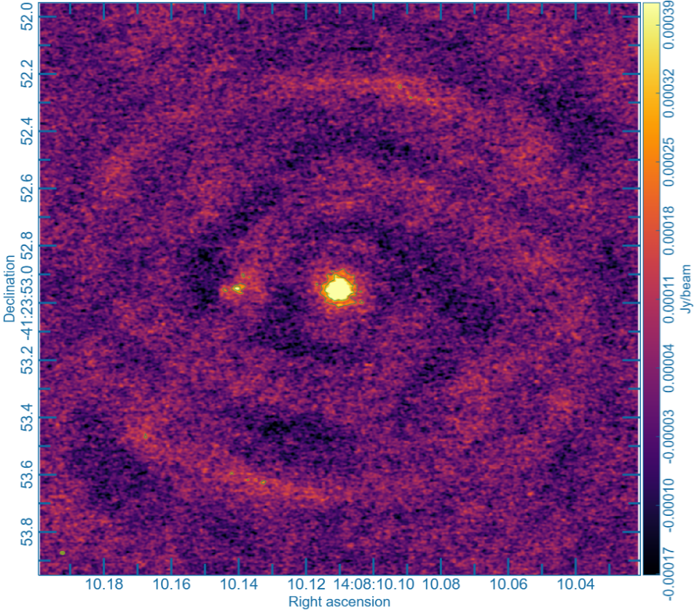
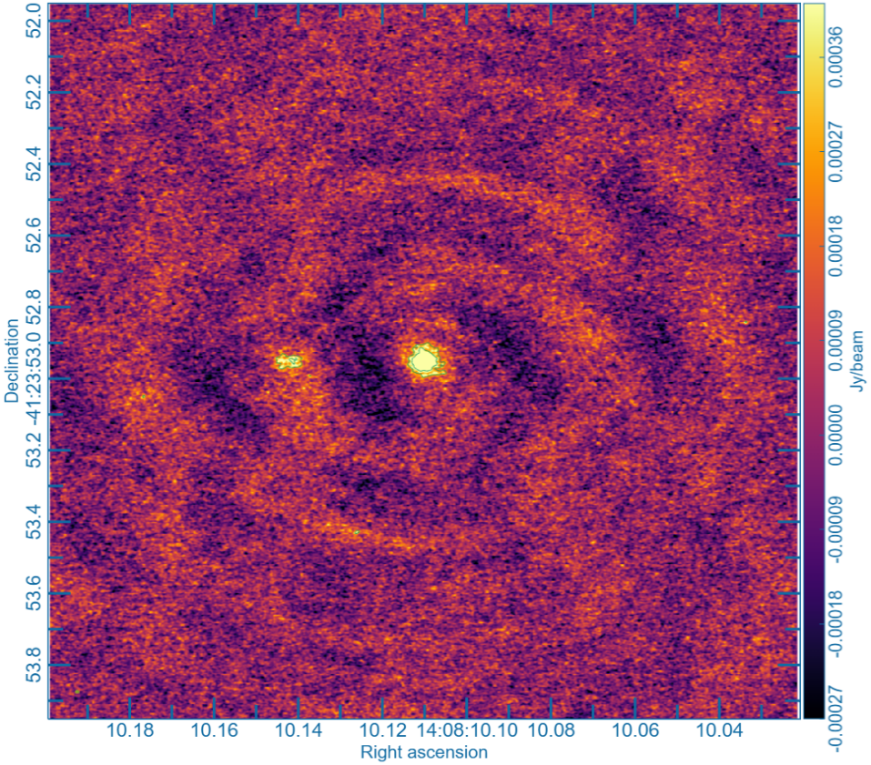
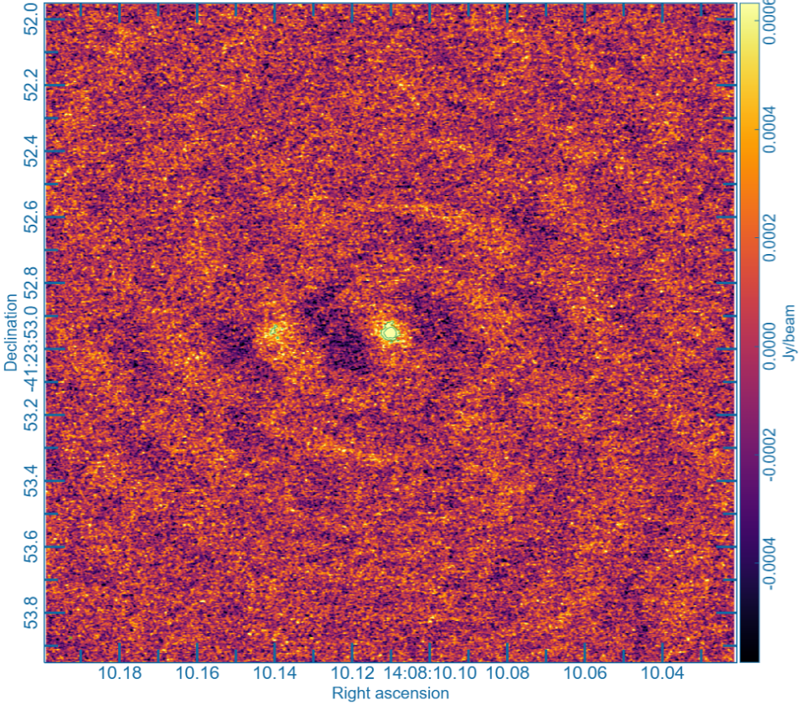
Synthetic Observations
Band 3: 100 GHz
Band 4: 150 GHz
Band 5: 185 GHz
Band 6: 230 GHz
Beam Size
Jy/beam
Band 7: 345 GHz
Band 8: 460 GHz
Band 9: 650 GHz
Band 10: 870 GHz
Declination
Right Ascension
Noisier, but higher resolution and brighter CPD

Slide 11
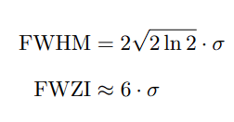
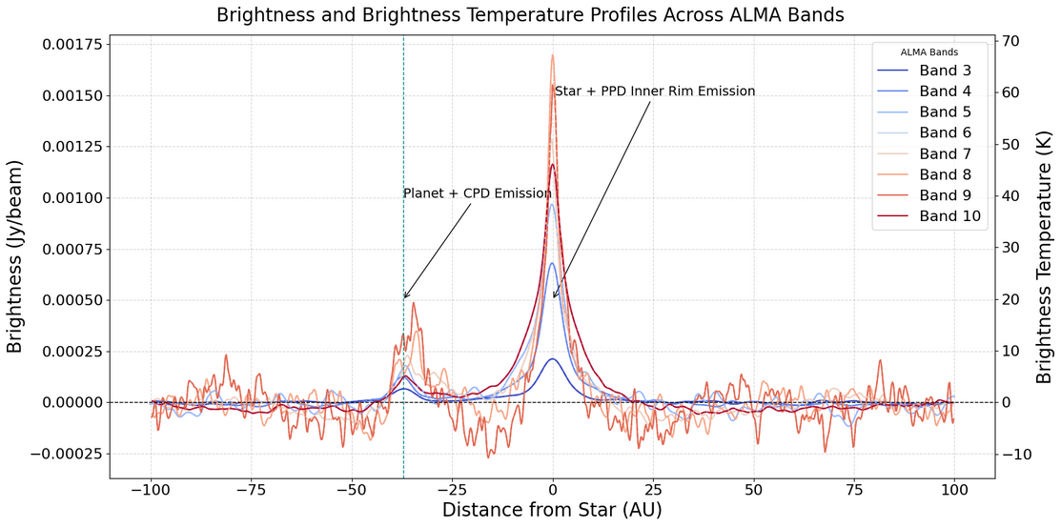
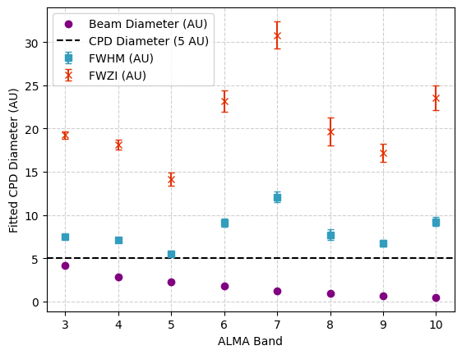
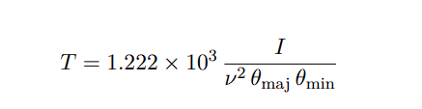
From Synthetic Observations:
RMS noise of image
Full Width at Half Maximum
Full Width at Zero Intensity
Radial Flux 2D Cut
Fitted CPD diameter

Slide 12
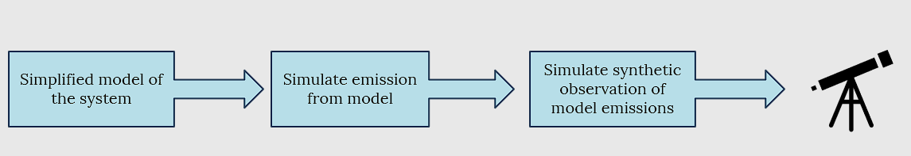
Conclusion
RADMC-3D
ALMA CASA
10-hour observation (ideal weather) enables 5σ detection in most bands
Band 1 remains undetected; Band 10 shows fragmented detection
CPD detection is feasible, but structural recovery is limited by atmospheric noise and beam dilution.
Optimizing ALMA bands to match CPD size offers the best trade-off between signal strength and resolution.

Slide 13
Limitations
Model resolution of CPD
Incorporate internal heating
Grain Distribution & Disk Gap
CPDs are optically thick and compact
High optical depth packed into more refined grid cells or smaller CPD might yield computational error.
Accretion and shock heating are modeled by calculating energy deposited in each grid cell.(Collins et al 1998; D’Angelo et al. 2003)
Alters thermal structure and overall disk morphology (shock fronts).
Massive planets carve out gap in PPD improves brightness contrast.
Current model uses two discrete dust sizes.
A continuous grain size distribution is more realistic and affects CPD opacity.

Slide 14
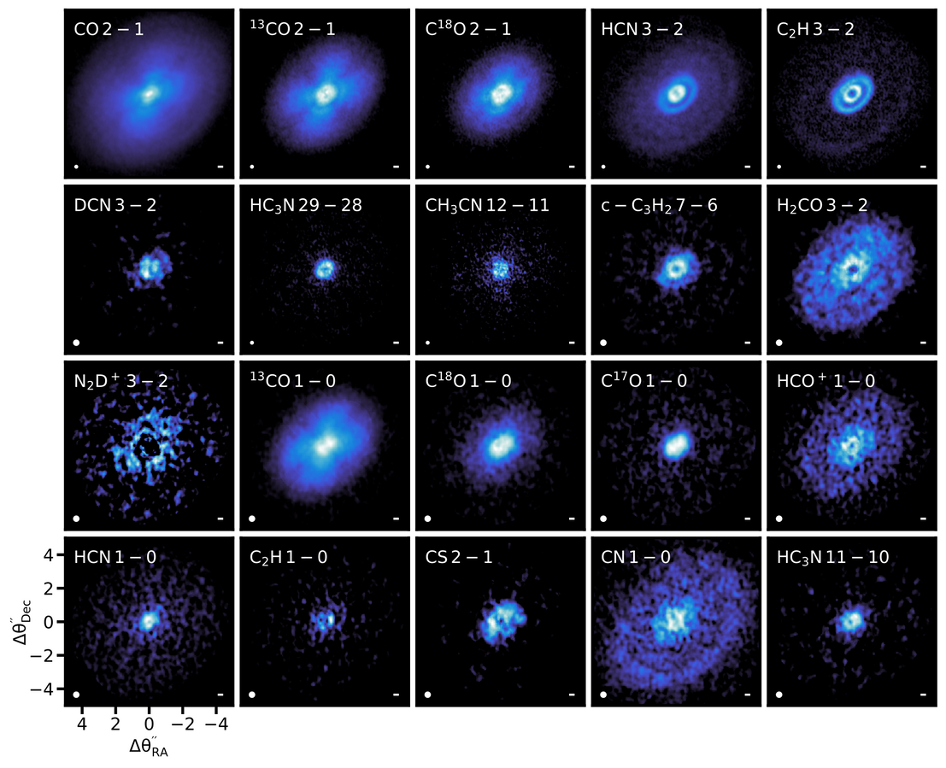
Future Developments
Add Gas Component
Include gas (e.g., SiS, SO, CO) in the model. Useful for detecting shocks and probing CPD surface dynamics.
Polarized Light Observations
Apply polarized differential imaging to isolate disk-scattered light. May reveal dust grain alignment in CPDs
Derive CPD properties
Experiment more ways to extract physical constraints from CPD observations.
Credit: Öberg et al.(2021)
PPD observed in different molecular gas emission wavelengths
Show significant morphological diversity and rich substructure
Notes:
After adding complexity to the model.
Provide more information
In gas kinematics to confirm it is CPD and measure properties of planet companion.

Slide 15
Reference
Armitage, Philip J. (2024). Planet formation theory: an overview. arXiv: 2412 . 11064[astro-ph.EP]. url: https://arxiv.org/abs/2412.11064.
Benisty, Myriam et al. (July 2021). “A Circumplanetary Disk around PDS70c”. en. In: The Astrophysical Journal Letters 916.1. Publisher: The American Astronomical Society, p. L2.issn: 2041-8205. doi: 10.3847/2041-8213/ac0f83. url: https://dx.doi.org/10.3847/2041-8213/ac0f83 (visited on 11/05/2024).
Chiang, E. I. et al. (Nov. 1997). “Spectral Energy Distributions of T Tauri Stars with Passive Circumstellar Disks”. In: The Astrophysical Journal 490.1, pp. 368–376. issn: 1538-4357.650doi: 10.1086/304869. url: http://dx.doi.org/10.1086/304869.
Collins, T. J. B. et al. (Aug. 1998). “Accretion Disk and Boundary Layer Models Incorporating OPAL Opacities”. In: 502.2, pp. 730–736. doi: 10.1086/305949.
D’Angelo, Gennaro et al. (Dec. 2003). “Thermohydrodynamics of Circumstellar Disks with High-Mass Planets”. In: The Astrophysical Journal 599.1, pp. 548–576. issn: 1538-4357. doi:10.1086/379224. url: http://dx.doi.org/10.1086/379224.

